Slide 1

OWN YOUR CAREER
3 WAYS TO ADVANCE

Slide 2

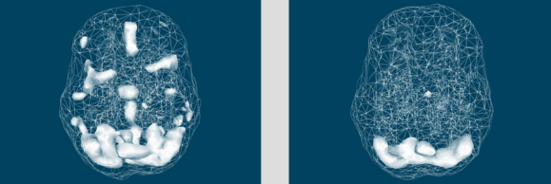
Which brain do you believe represents a brain at rest?
Brain 1 Brain 2
*courtesy of Dr. Daniel Amen

Slide 3
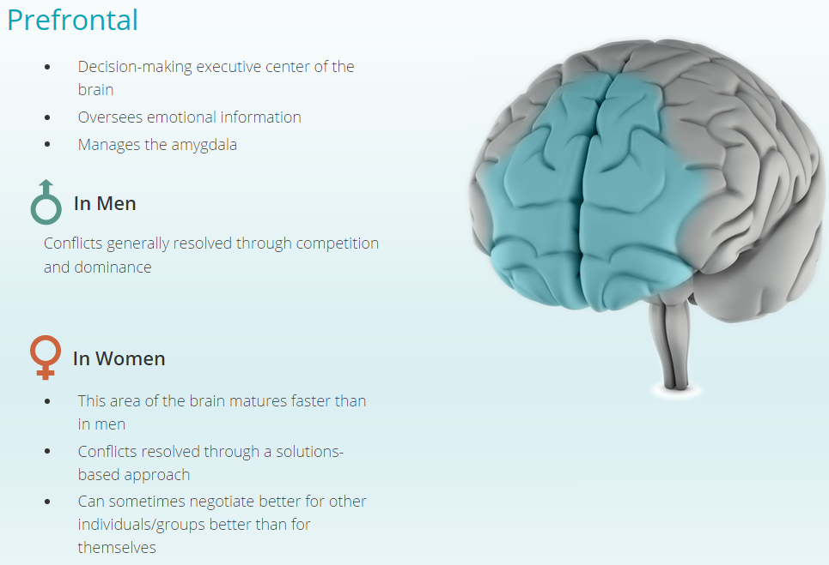
Amen, D, Trujillo, M, Keator, D, et al. “Gender differences in rCBF in a healthy and psychiatric cohort of 46034 SPECT scans.” Amen Clinics. 2013.
Annis, Barbara, Gender Intelligence Group – BeGenderIntelligent Learning Experience. 2016.

Slide 4
COMPANIES WITH THE GREATEST GENDER DIVERSITY SEE 2 TIMES MORE REVENUE AND 34 % HIGHER PROFITS ON AVERAGE
[1] UC Davis Graduate School of Management Study, 2014-2015
[2] Adler, Roy D (2001), Women in the Executive Suite Correlate to High Profits, Glass Ceiling Research

Slide 5
12 YEARS OF NO CHANGE
less than 22% of senior management positions globally
make 23% less than men
117 years to reach parity
Source: Grant Thornton IBR 2014

Slide 6


Slide 7

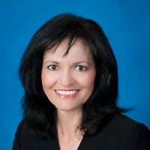

Marina Bogard,
SVP Global Strategic Accounts

Slide 8
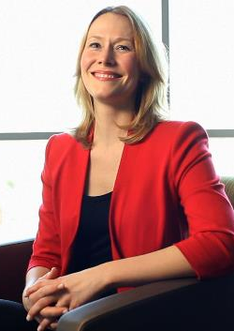

Jennifer Miller,
Marketing Engineer

Slide 9


Slide 10


Slide 11


Slide 12


Slide 13


Slide 14


Slide 15
1. Know Your Values
2. Own Your Review
3. Give & Ask for Support

Slide 16


Slide 17

Shavon Lindley, CEO
www.womenevolution.com
shavon@womenevolution.com
858-539-3929

